Slide 1
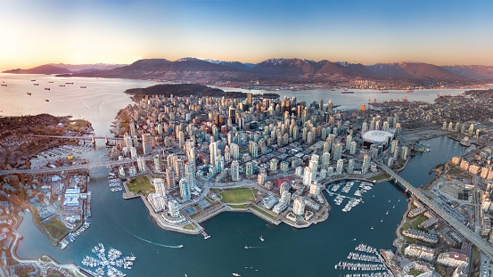
VANCOUVER, BC
FERRIS BAND, CHOIR, and ORCHESTRA
May 25-28, 2023

Slide 2
TOUR PACKAGE:
Private Charter Service
Three-night hotel accommodations
Festival Participation
Post-performance workshop
Harbor Dinner Cruise
Group Dinner (Boston Pizza Company)
Capilano Suspension Bridge Complex
Granville Island, Downtown Vancouver – Robeson St., Stanley Park

Slide 3
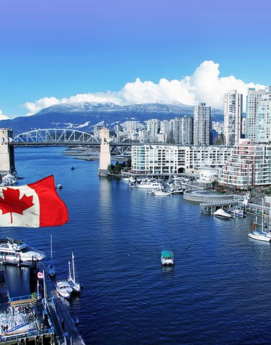
VANCOUVER, CANADA
Trip Cost: $850
Payment Plan
Monthly payments
Payment slip reminders
Payment Locations/Sources
World Strides – Payment/Registration Portal
Trip package, Festival package, Hotel, Experiences
FMPA – PO Box (mail) or FMPA Mailboxes in the rooms.
Northwestern Coaches, Tour T-shirt

Slide 4
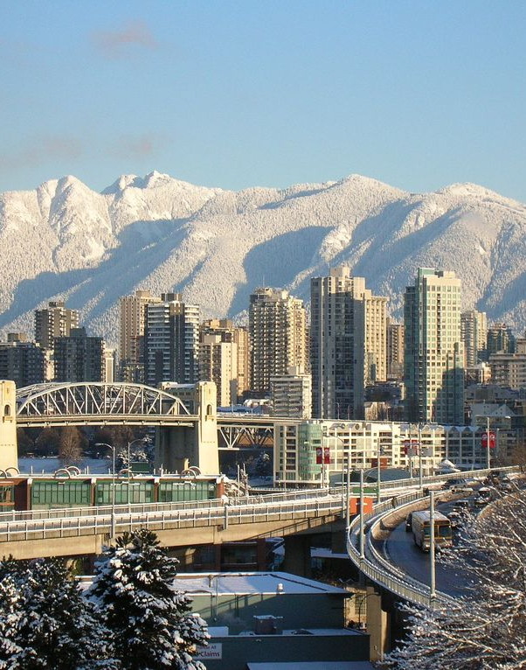
TRAVEL REQUIREMENTS:
Students 18 and Under
Certified Copy of Birth Certificate – County of birth
Passport / Enhanced Drivers License
School ID and Washington State Issued ID (if you have)
Adults - Chaperones/Directors
Passport or Enhanced Drivers License
Washington State ID

Slide 5
FUNDRAISERS!
Butterbraids – NOW
Coffee – Soon
Fruit – NOW
RaiseRIGHT – NOW
Concession Stand – NOW
Visit our websites to get fundraiser information. Look under the FMPA tabs.

Slide 6
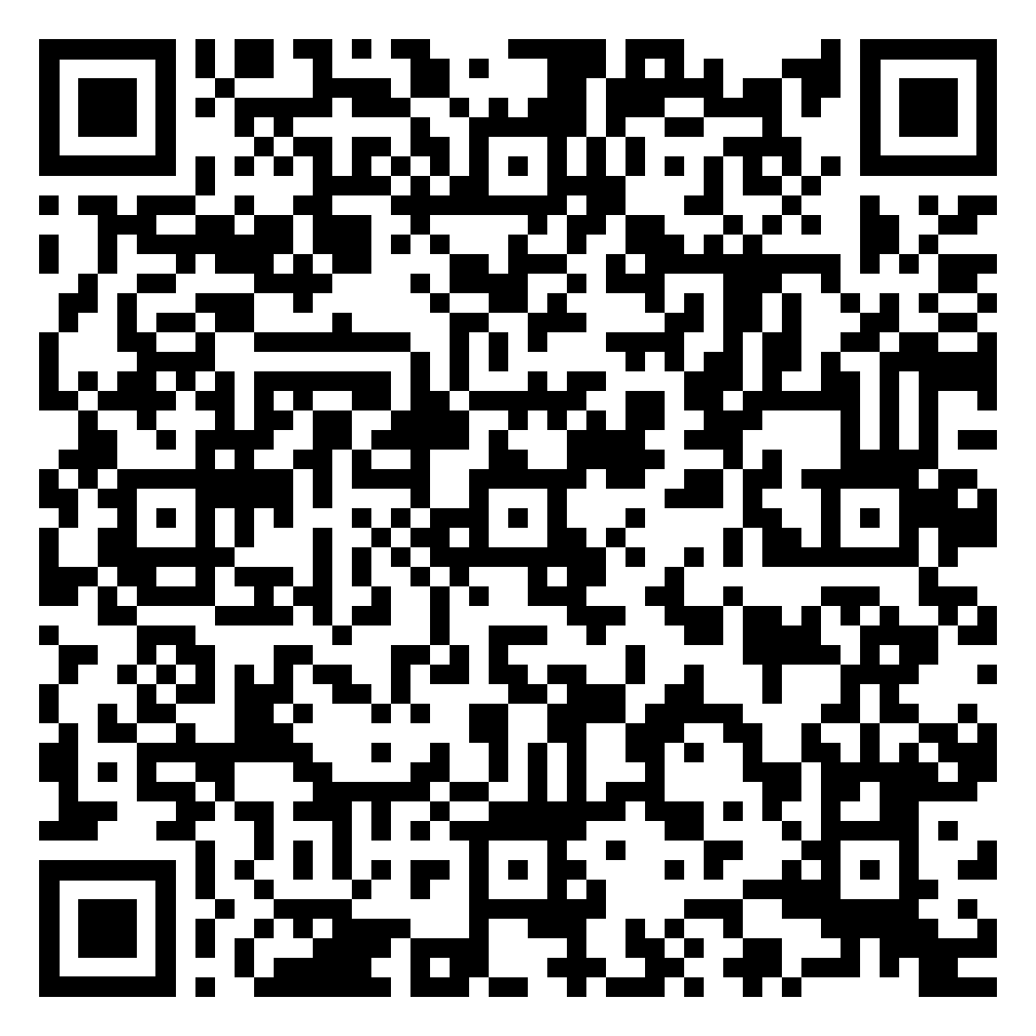
VANCOUVER REGISTRATION:
FOLLOW THIS QR CODE TO GET REGISTERED, NOW!

Slide 7
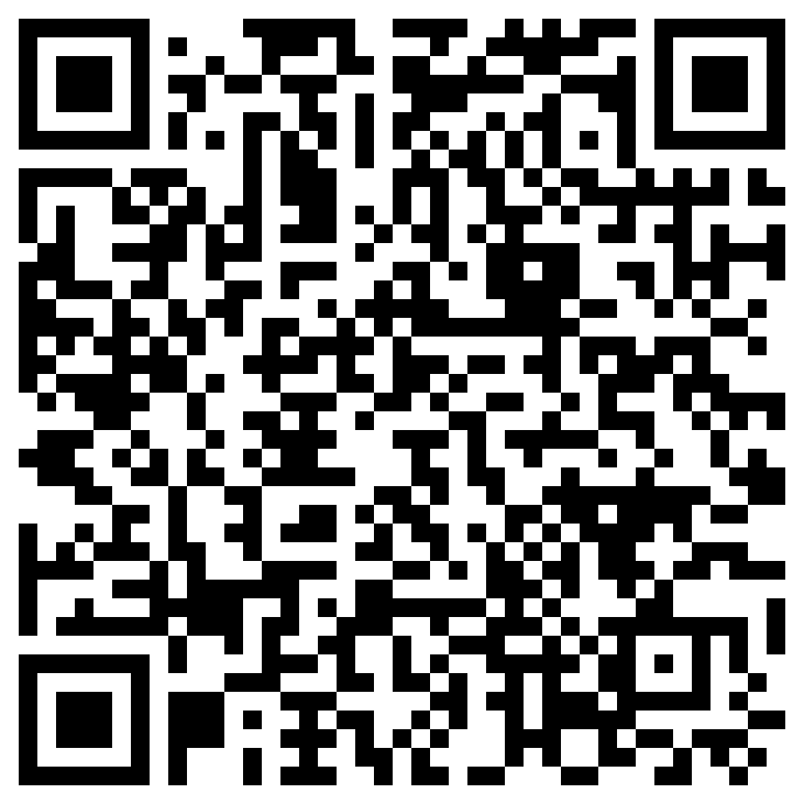
CHAPERONE!
If you are interested in chaperoning the trip, please use this QR Code to indicate your want to travel with us.

Slide 8
VANCOUVER, CANADA
Incredible City
Beautiful Location
Wonderful Trip
Fantastic people!
Outstanding Music
SO. MUCH. FUN!

